Slide 1
Cloud Computing
By
Veepin Kumar
Assistant Professor
KIET Ghaziabad

Slide 2
Virtualization in Cloud Computing
Virtualization is the "creation of a virtual (rather than actual) version of something, such as a server, a desktop, a storage device, an operating system or network resources"
In other words, Virtualization is a technique, which allows to share a single physical instance of a resource or an application among multiple customers and organizations.
It does by assigning a logical name to a physical storage and providing a pointer to that physical resource when demanded

Slide 3
Concept behind the Virtualization
The machine on which the virtual machine is going to create is known as Host Machine and that virtual machine is referred as a Guest Machine

Slide 4
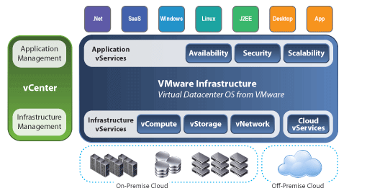

Slide 5
Types of Virtualization
Hardware Virtualization
Operating System Virtualization
Server Virtualization
Storage Virtualization

Slide 6
Hardware Virtualization
When the virtual machine software or Virtual Machine Manager (VMM) is directly installed on the hardware system is known as hardware virtualization
The main job of hypervisor is to control and monitoring the processor, memory and other hardware resources
After virtualization of hardware system we can install different operating system on it and run different applications on those OS
Usage:
  Hardware virtualization is mainly done for the server platforms, because controlling virtual machines is much easier than controlling a physical server

Slide 7
Operating system Virtualization
When the virtual machine software or Virtual Machine Manager (VMM) is installed on the Host Operating System instead of directly on the hardware system is known as Operating System Virtualization
Usage:
  Operating System Virtualization is mainly used for testing the applications on different platforms of OS

Slide 8
Server Virtualization
When the virtual machine software or Virtual Machine Manager (VMM) is directly installed on the Server system is known as Server Virtualization
Usage
  Server virtualization is done because a single physical server can be divided into multiple servers on the demand basis and for balancing the load

Slide 9
Storage Virtualization
Storage virtualization is the process of grouping the physical storage from multiple network storage devices so that it looks like a single storage device
Storage virtualization is also implemented by using software applications
Usage
  Storage virtualization is mainly done for back-up and recovery purposes.

